Slide 1

Jigyaasa
TEAM PARICHAAY.
Members: Rugved Kharbade Sakshi Padwal Chirag Sonavale

Slide 2
About the Project.
1.With the ever growing need for learning more skills, online courses have taken the front seat in the education area.
2.Considering this we are designing a portal to best fit amongst all the top courses, including all the age groups and their interests.

Slide 3
The core advantages of such platform
1. Flexibility→ With online education, students can take courses anytime, anywhere.
2. Self-paced mode→ Students are free to set the schedule according to their individual needs.
3. Lower costs→ Courses on online platform are often cheaper than traditional campus environment.

Slide 4
1. Transforming learning into Amazing e-learning Experiences through Explore and Project Building.
EXPLORE
This variant is for the people who are passionate and want to find new things to understand and skills to learn.
PROJECT BUILDING.
This variant is for the people who are currently involved a project which demands certain skills to be undertaken.

Slide 5
2. To develop Learner Motivation And Engagement.
Test Series.
Chapterwise
&
Full portion.
Rewards.
Perks for maintaining Learning Streak

Slide 6
3.Staying up-to-Date With Modern Tech.
TRENDING.
Trending Links, Articles, Videos will be available in this section.
SEMINARS.
To get acquainted with new and upcoming technology.

Slide 7
4. Designing e-learning Courses For Different Generations from CHILDREN TO OLD AGE PEOPLE.
Arts & Culture
Science & Technology
Politics
Accounting & Finance
Others
Physical Fitness(Yoga)

Slide 8
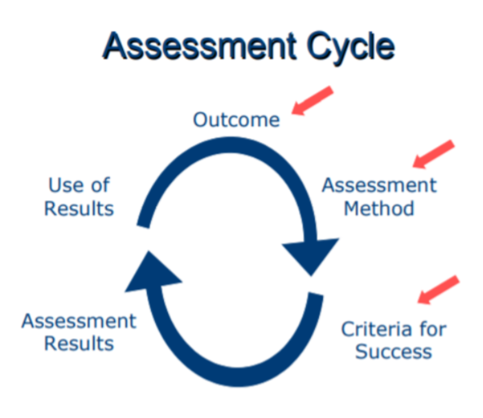
5. Measurable learning outcomes.
Competitions
Rankings
Tackle industry problems

Slide 9
6. Adaptive learner models to accommodate different learner needs.
Downloadable Content
Mentors
Connect with creators
Learn at your pace
Achivements

Slide 10
Thankyou

